Slide 1
Unit-4
Machine Learning
Introduction & Concepts

Slide 2
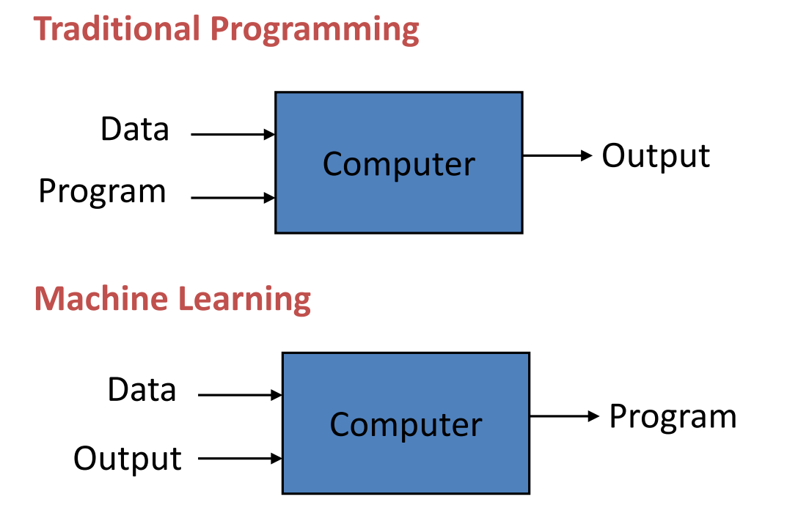
(Algorithm)

Slide 3
Algorithm
An “Algorithm” in machine learning is a procedure that is run on data to create a machine learning “model.”
It is commonly said to be fit on a dataset which means it is applied on the dataset.
E.g. Types of algorithms are –
Regression, Classification & Clustering

Slide 4
Model
A “Model” in machine learning is the output of a machine learning algorithm run on data.
It represents what has been learned from “learning” the algorithm on the data.
Machine Learning Model == Model Data + Prediction Algorithm
Linear Regression:
Algorithm: Find a set of coefficients that minimize error on the training dataset
Model:
Model Data: Vector of coefficients
Prediction Algorithm: Multiple and sum coefficients with input row

Slide 5
Machine Learning
Learning is the ability to improve behavior based on experience.
Machine Learning –
Explores algorithm
Learn/Build models for data
Models used for prediction, decision-making, solving tasks, etc.

Slide 6
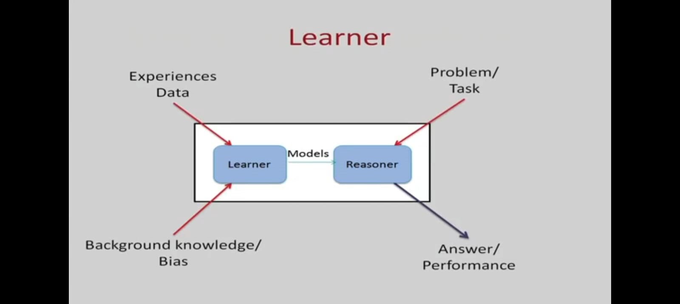

Slide 7
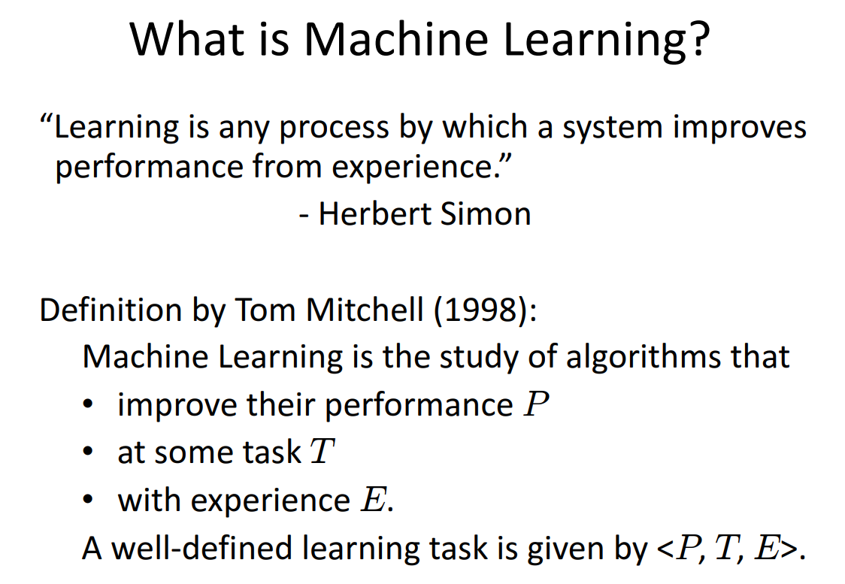

Slide 8
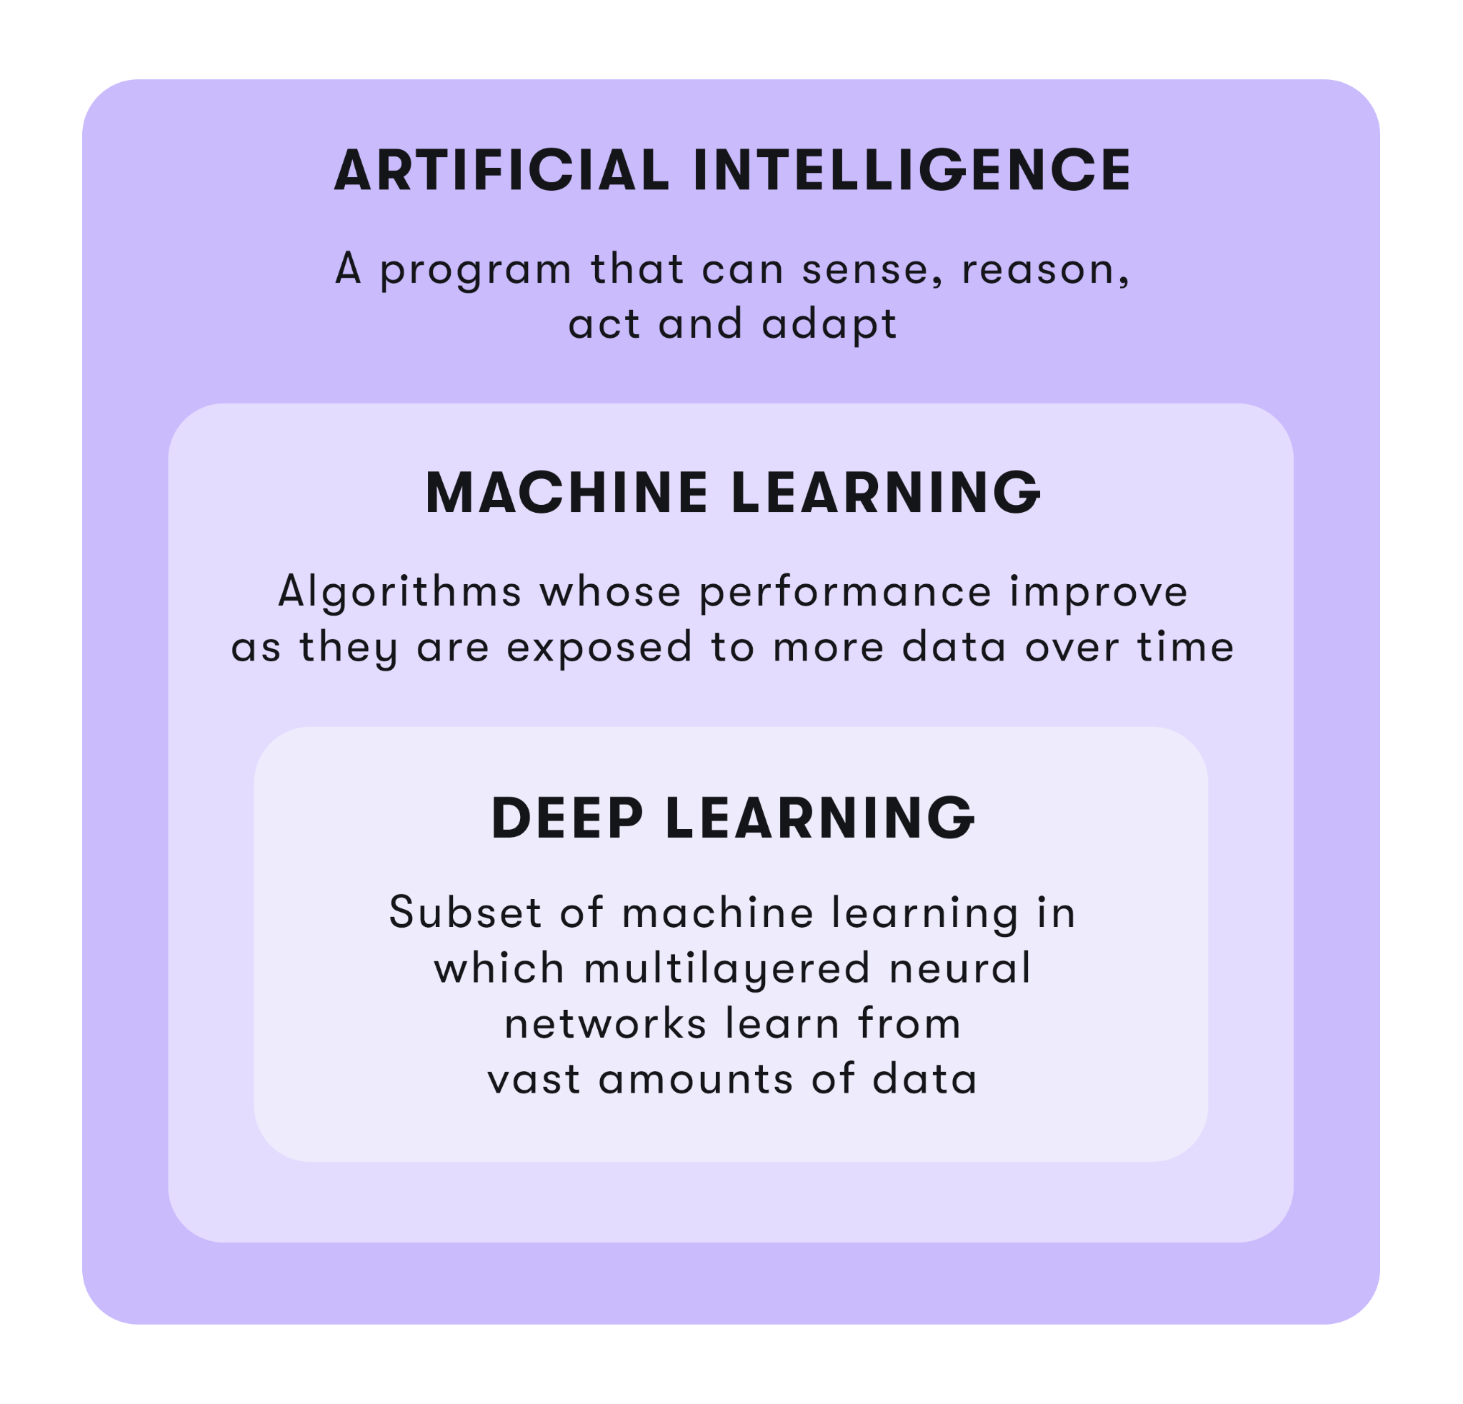

Slide 9
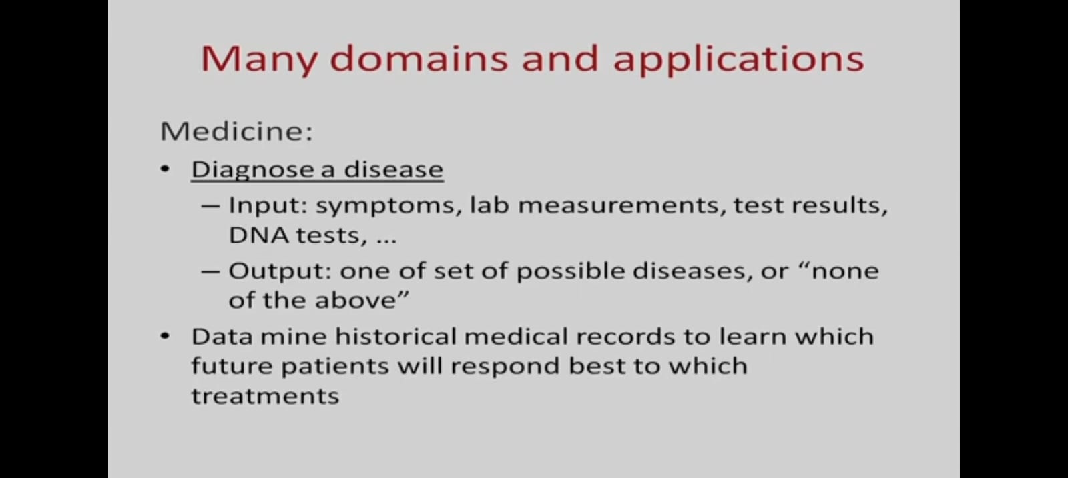

Slide 10
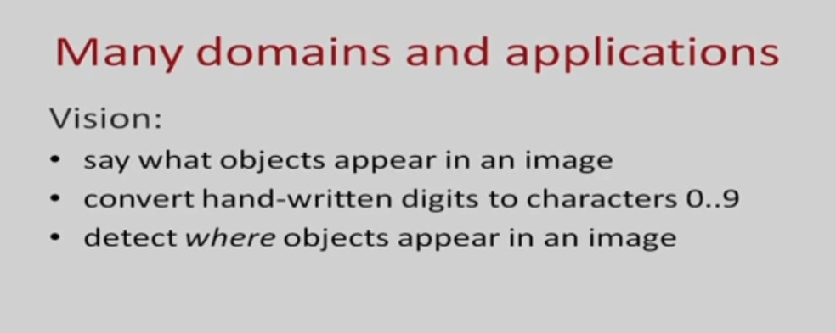
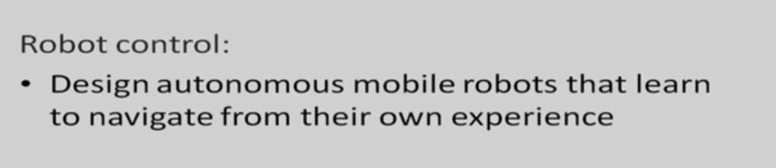
Computer

Slide 11
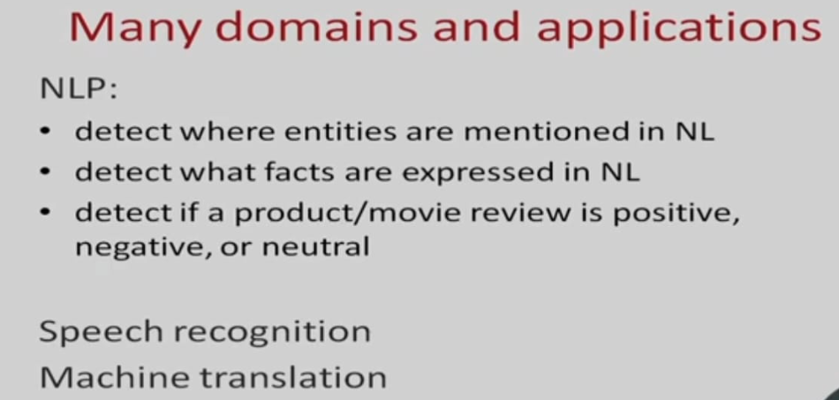

Slide 12
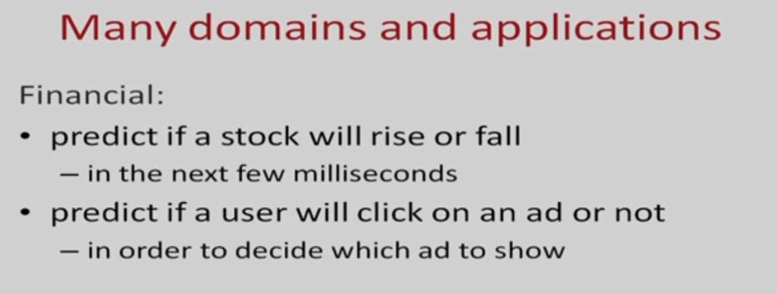
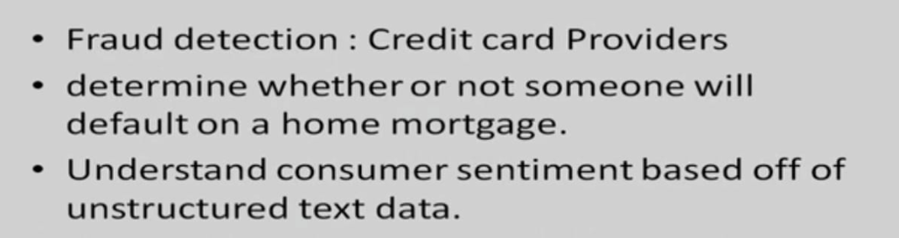

Slide 13
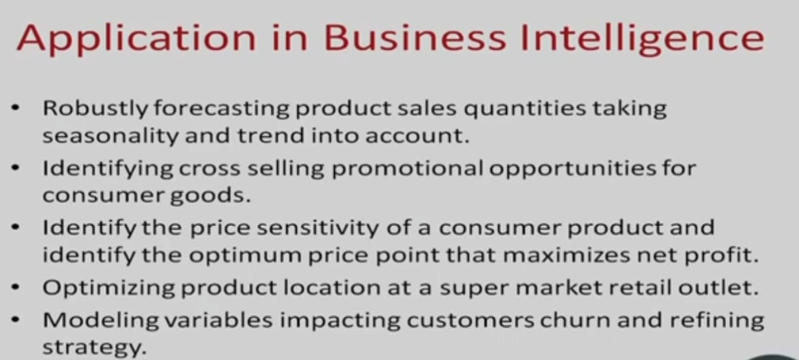

Slide 14
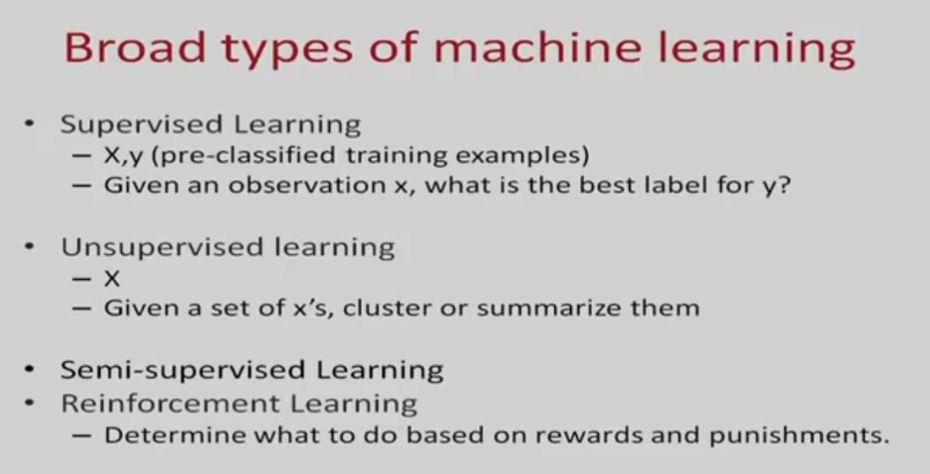

Slide 15
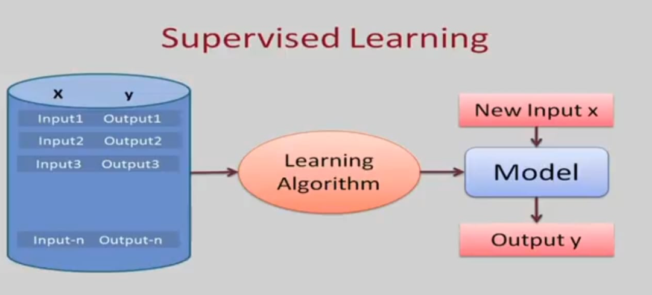

Slide 16
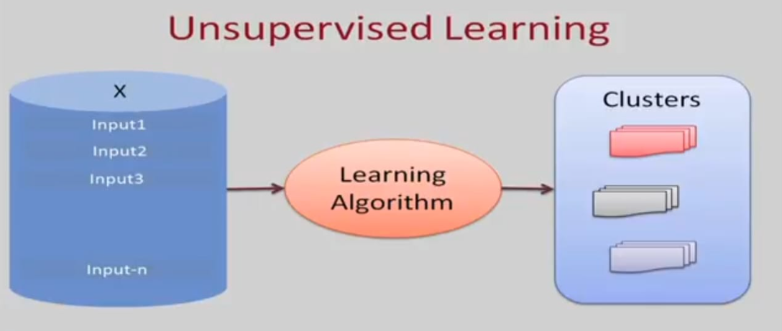

Slide 17
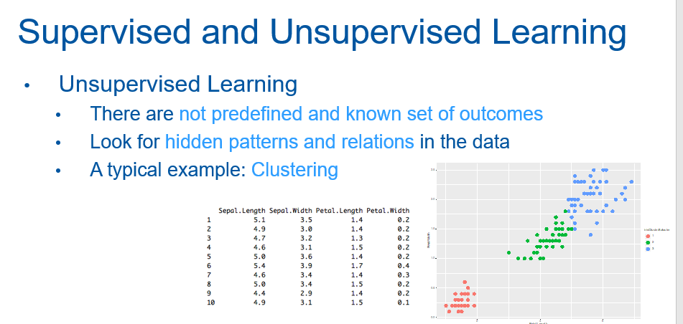

Slide 18
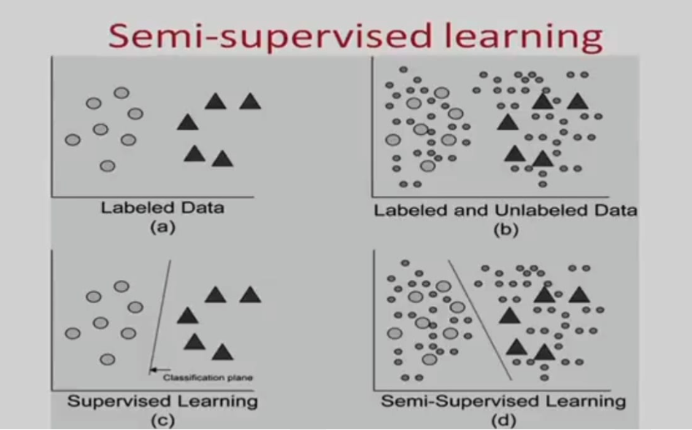

Slide 19
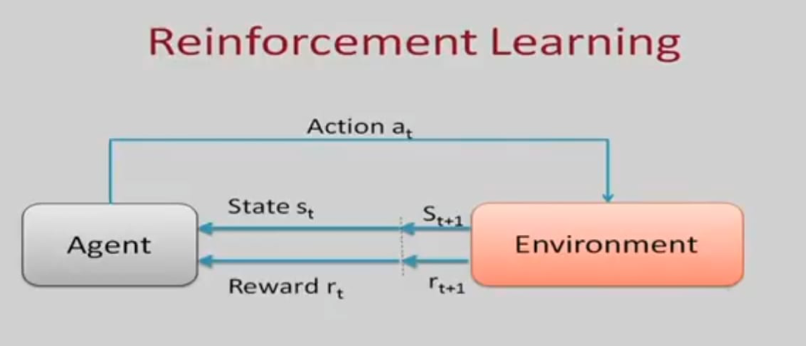

Slide 20
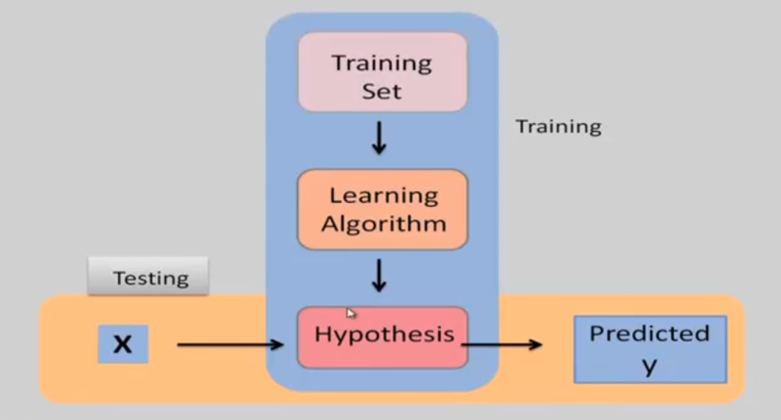
Discrete –
Classification
Continuous –
Regression

Slide 21
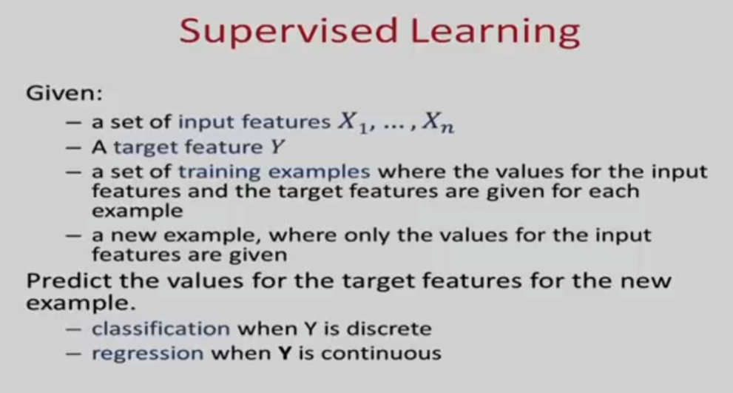

Slide 22
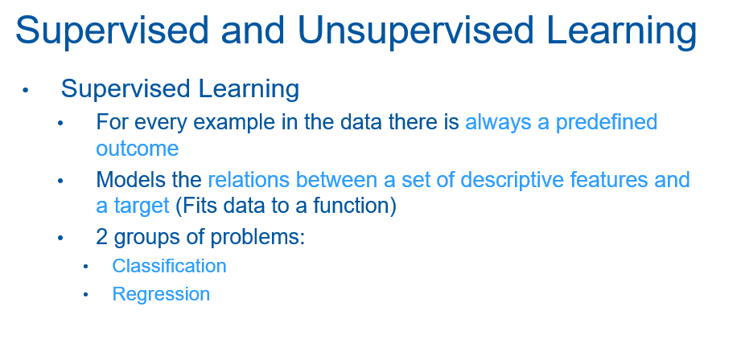

Slide 23
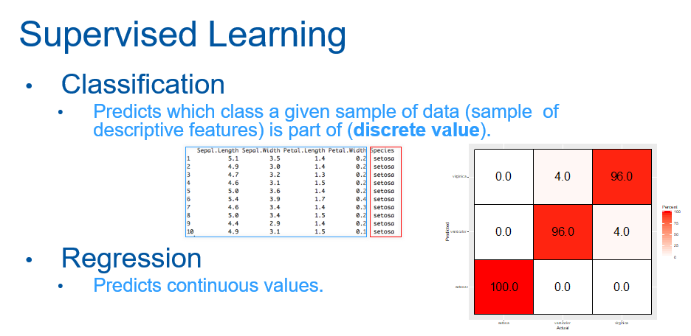

Slide 24
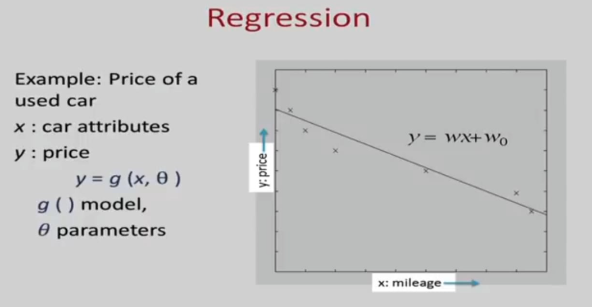

Slide 25
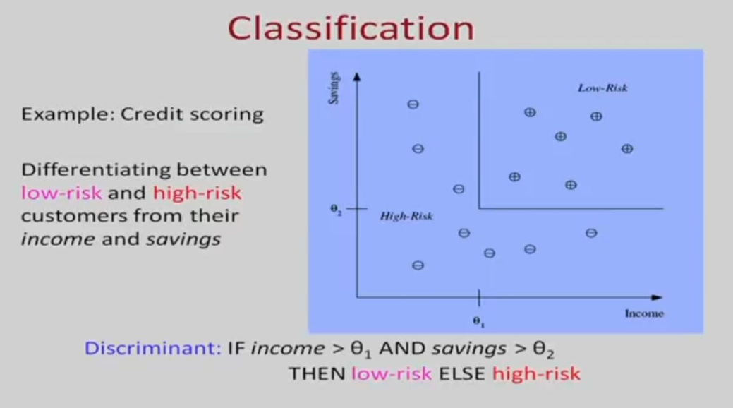

Slide 26
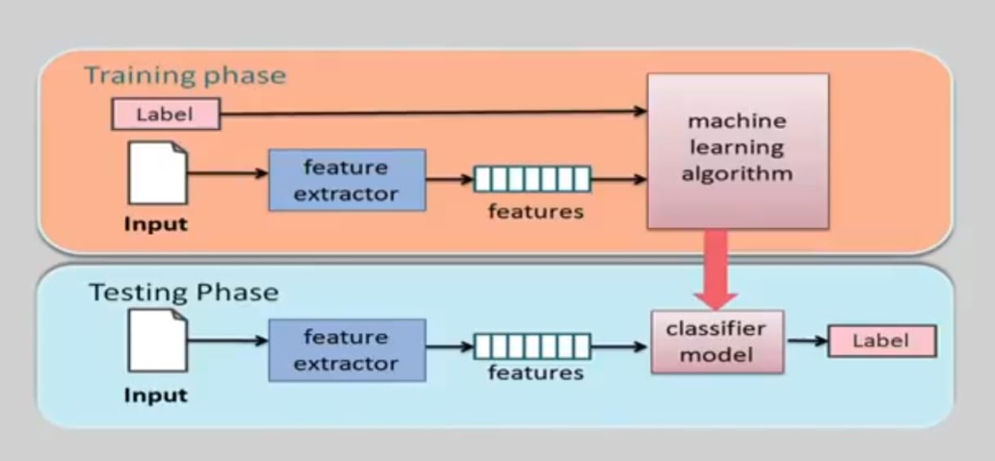

Slide 27
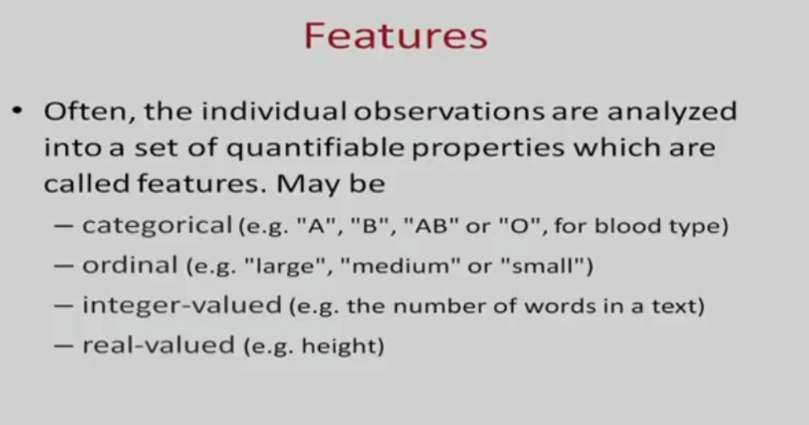

Slide 28
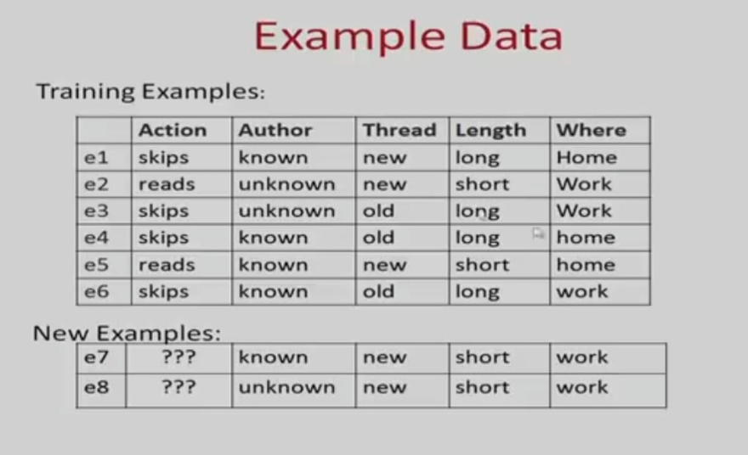

Slide 29
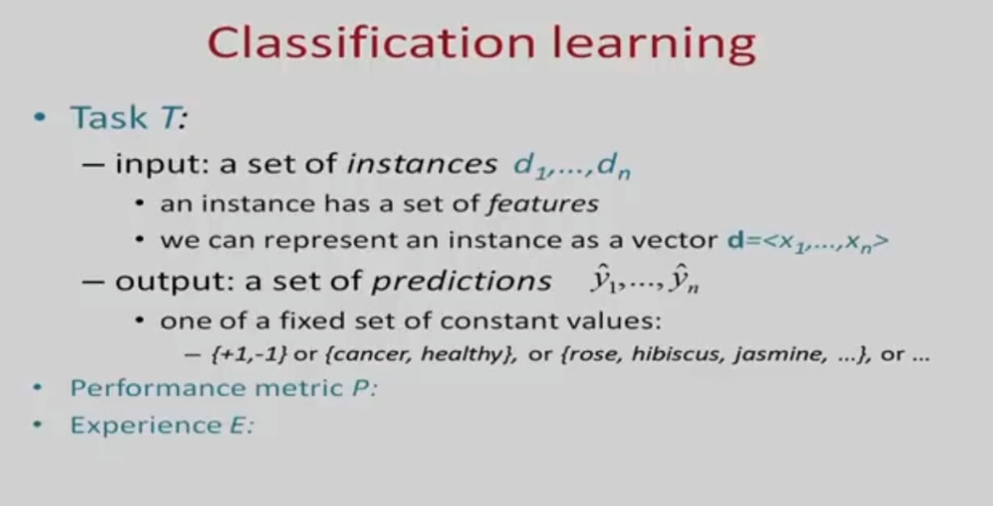
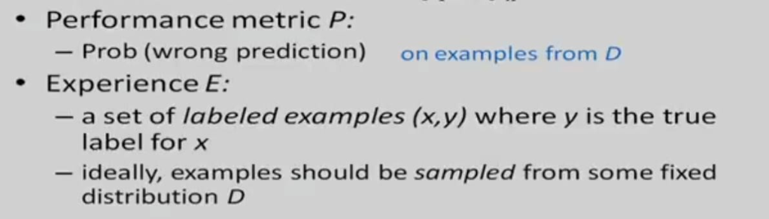

Slide 30
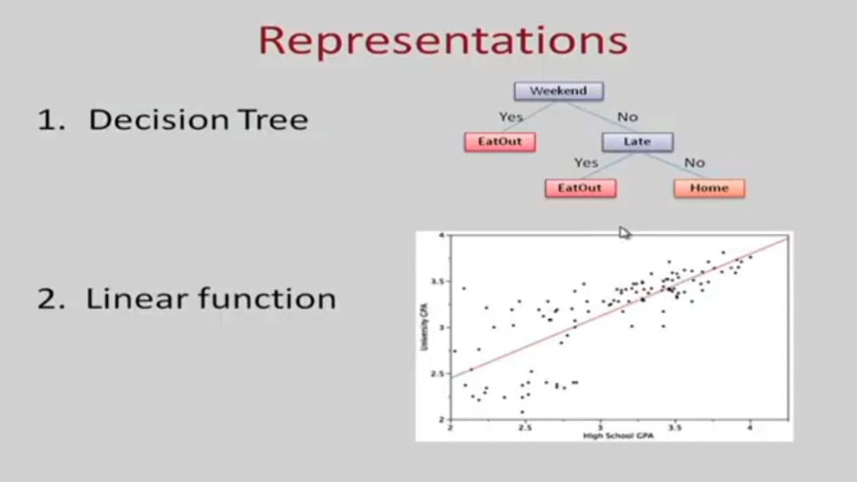

Slide 31
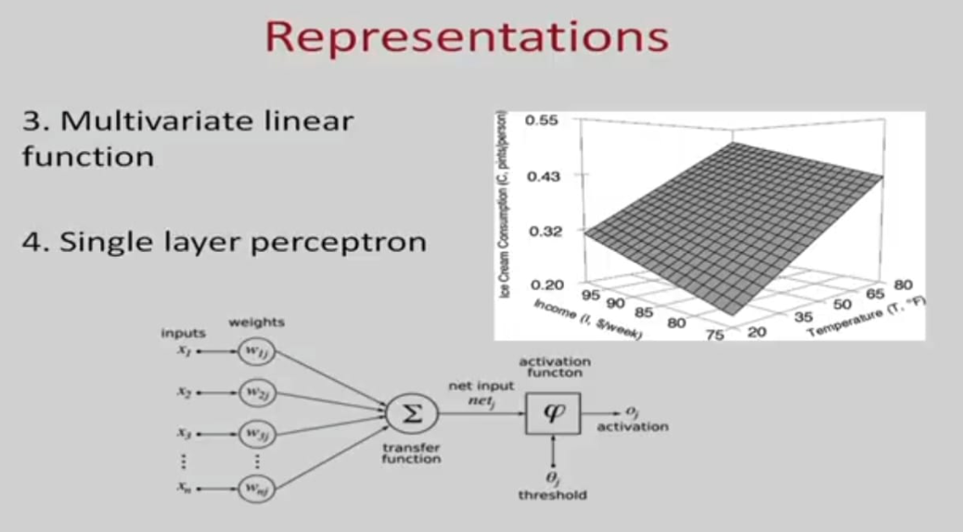

Slide 32
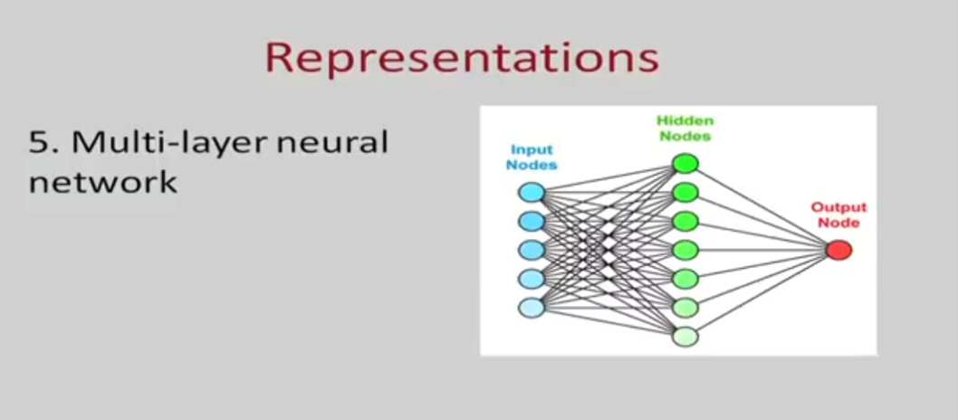

Slide 33
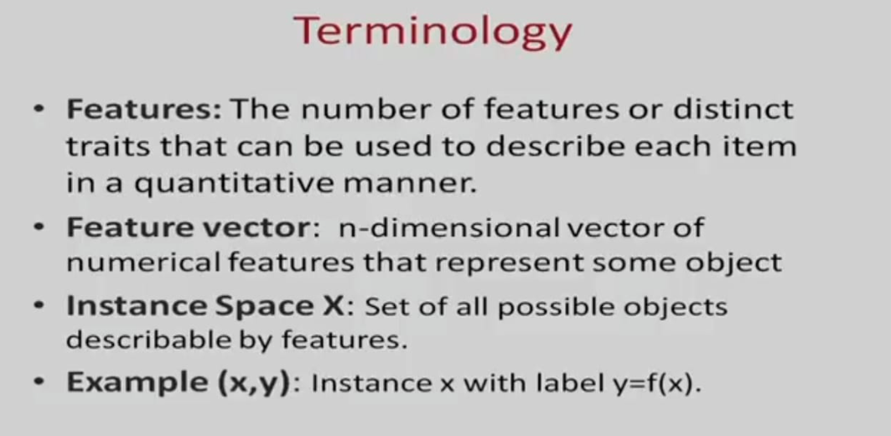

Slide 34
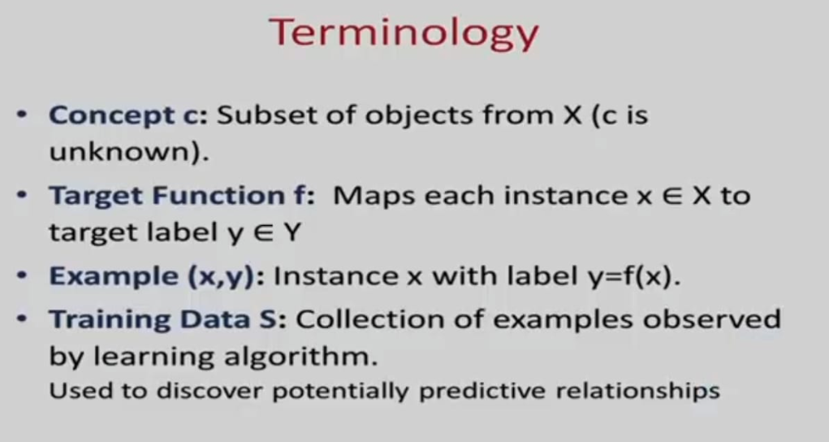

Slide 35
Supervised Vs Unsupervised Learning
Parameters | Supervised Learning | Unsupervised Learning
Input Data | Algorithms are trained using labeled data. | Algorithms are used against data that is not labeled
Accuracy | Highly accurate | Less accurate
Algorithms used | Linear and Logistics regression, Random forest, Support Vector Machine, Neural Network, etc. | K-Means clustering, Hierarchical clustering, Apriori algorithm, etc.

Slide 36
Supervised & Unsupervised ML Algorithms
Supervised Learning | Unsupervised Learning
Regression Logistic Regression Classification Naive Bayes Classifiers K-NN (k nearest neighbors) Decision Trees Support Vector Machine | Clustering Association

